Slide 1
ESCA Certification in Slovakia
Vladimír Borza-Renáta Magulová
INNO INUSTRY –online study visit Slovakia
„Cluster support and transformation towards Industry 4.0“
20.01.2022

Slide 2

RECENT HISTORY OF CERTIFICATION
2011- start of certification in Slovakia according to the criteria of European Secretariat of Cluster Analyses (ESCA)
from 2011 – certification in connection with international projects
          CENTRAMO (2011-2013)
          ACE – Achieving Cluster Excellence (2014-2016)
          ClusterFY (2017-present)
2011-2013 – outputs of early ESCA certification – first 14 bronze clusters and 1 gold cluster in Slovakia
from 2011 – building SIEA Expert Team in cooperation with VDI/VDE in Germany
2013 – start of systematic cooperation: MoE and SIEA with cluster organizations: 1st Call for support of industrial cluster organizations in 2013 (state budget),
first SIEA study – Cluster Policy in Conditions of Slovakia (M. Balog et al. 2015)

Slide 3
CURRENT SITUATION
National Project „Increasing the Innovative performance of the Slovak economy“ – let´s innovate.sk
One of objectives: to intensify the processes of building the part of the innovation ecosystem that is formed by cluster organizations
Over the last 4 years, 40 certification/recertification was performed
23 Slovak clusters have valid ESCA certificates to the date of 1. January 2022 - which is the most within the V4 countries and Austria.
Support from the OP Integrated Infrastructure – grants for clusters in the Bratislava self-governing region with total allocation 2.3 mil. EUR and in other regions of Slovakia with total allocation 2.7 mil. EUR
Number of approved or contracted projects: 21

Slide 4
IMPACT OF CERTIFICATION ON THE CLUSTER ECOSYSTEM
Increasing cluster activities within the ecosystem
Creation of new clusters (10 new active clusters in the last three years)
New or updated cluster profiles on the ECCP platform (19)
Linking cluster assessments with cluster support schemes
Internationalization of clusters
Improving the quality of internal cluster management
Sharing of information between SIEA, MoE, UKS networks, individual clusters ...

Slide 5
OUTPUTS AND RESULTS
Creating and Implementing of two Calls from the European Structural Funds to Support Business Networking,
Creation of a cross-sectional "Stakeholder Group" (SIEA, MoE, UKS, representatives of ClusterFY and INNO Industry projects),
Completion of the SIEA expert team in cooperation with VDI VDE,
Preparation of a national certification system for industrial clusters,
Preparation of an updated version of the DM Scheme for the Support of Industrial Cluster Organizations (support from the state budget)
Raising awareness of the clusters importance
Increased interest of SMEs in joining clusters

Slide 6
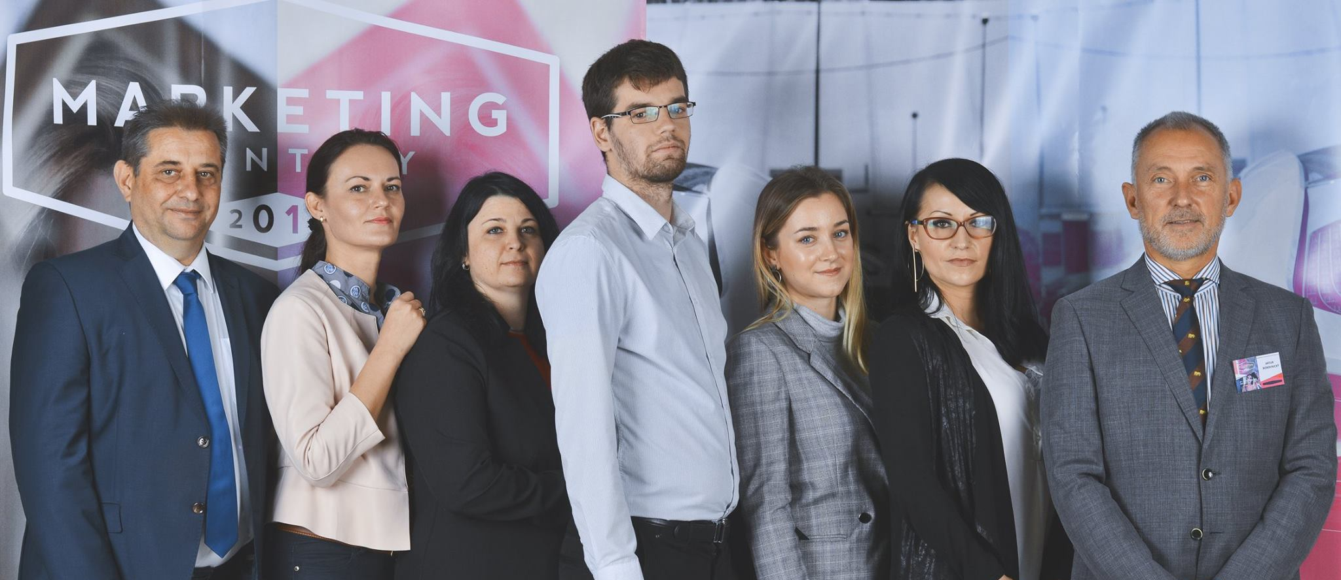
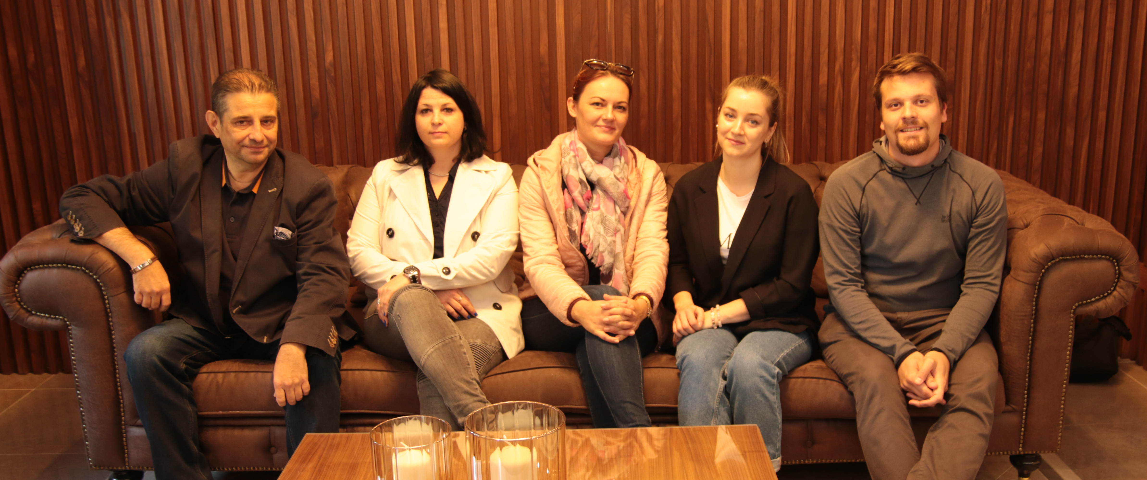
SIEA Expert Cluster Team
Ing. Artur Bobovnický CSc.
RNDr. Vladimír Borza
Ing. Peter Adamovský, PhD.
RNDr. Katarína Ružičková
Ing. Renáta Magulová
Mgr. Alexandra Vavrdová
Ing. Lucia Vančo

Slide 7
NEWS form the ClusterFY project
11/01/2022: ClusterFY Workshop on cluster performance in pandemic era with following agenda:
Presentation of a jointly performed survey in ClusterFY partner regions: „COVID19 impact on clusters: needs, challenges and recovery process„
Presentation on TCIs findings from clusters in COVID recovery study
More information from webinar are available on the Slovak cluster monitor: https://www.inovujme.sk/sk/aktuality

Slide 8
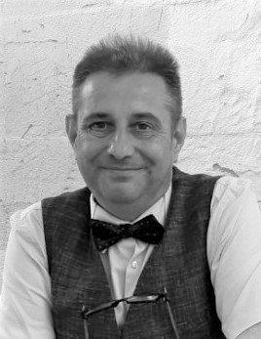
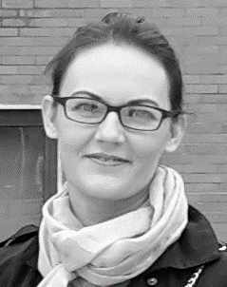
DISCUSSION
Thank you for your attention
Q & A
vladimir.borza@siea.gov.sk
&
renata.magulova@siea.gov.sk

